Slide 1
Lab tutorial
Anna-Liisa Peikolainen
Research fellow in materials technology
Intelligent Materials and Systems Laboratory
Institute of Technology
University of Tartu

Slide 2
Outline
Chemistry lab rules
324
326 Gray room
Fire safety
Notes:
The tutorial covers two important topics: first, the rules that must be followed in our chemistry labs and second, fire safety with instructions on how to act in the case of fire. The fire safety tutorial will continue on the 3rd floor, where we shall examine the evacuation plan, discuss the procedure of evacuation, find the locations of fire extinguishers and first aid kits. At the end of tutorial, please give a signature to confirm that you have been instructed. You can also find the safety information on IMS wiki site. The original documents are in Estonian.

Slide 3
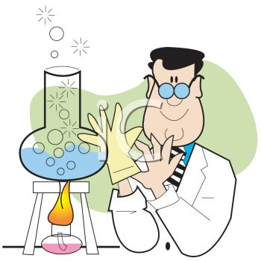
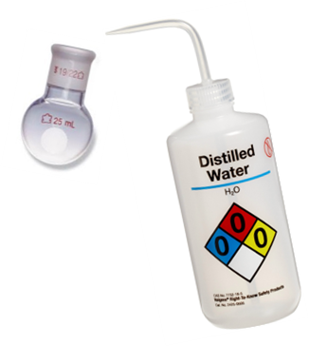
Chemistry Lab Rules
Planning
Experimenting
Cleaning
www.clipartguide.com
Notes:
Chemistry lab rules are based on chemistry lab safety instructions of institute of chemistry, UT and here I devided them into three sections: planning, experimenting and cleaning. These three parts are equally important and must be carried out carefully to get trustworthy and valid results, avoid accidents and stay friends with colleagues.

Slide 4
Planning

Slide 5
Know your chemicals
Planning
MSDS (Material Safety Data Sheet)
Hazard pictograms
Notes:
When planning your experiments, you need to know your chemicals, the reactions and instruments you are going to use. The first information on chemicals and hazardous reactions can be found on hazard pictograms on the container labels of the chemicals and material safety data sheets. MSDS are available in the internet.
Hazard pictograms can look different depending on the system and time.

Slide 6
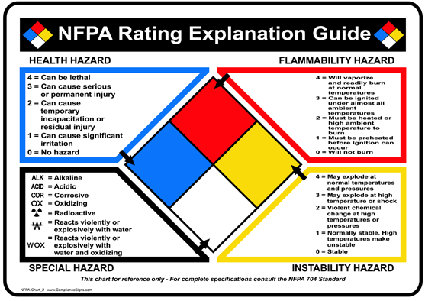
Hazard Pictograms
Planning
Notes:
For example, National Fire Protection Association (NFPA) evaluates chemicals by hazard level with corresponding numbers depicted on the pictogram. We saw a bottle of distilled water earlier.

Slide 7
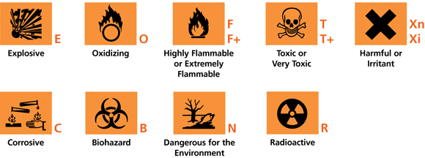
Planning
Hazard Pictograms
Notes:
Until 2010 the pictograms classified according to The Globally Harmonized System for Hazard Communication were as shown here. Then new nine pictograms were implemented.

Slide 8
Hazard pictograms
Planning
Notes:
Some symbols are similar, there are two new symbols in new Classification and Labeling of Chemicals (CLP) as well: gas under pressure and serious health hazard.
In our chemistry lab there is a sticker on the oven door about which pictograms were replaced and which are new, so it is convenient to check. Such stickers by Estonian Health Board have been brought as an excellent example of informing about new pictograms by European Chemicals Agency (ECHA).

Slide 9
Know the reactions
Planning
Know your chemicals
Know the reactions
dangerous gases
exothermic reactions
etc.
Know the risks of your experiment and be ready to take precautions
Notes:
In addition to knowing your chemicals, you must also know the reactions and be aware about possible risks. If there are exothermic reactions or dangerous gases evolving during the experiment, you must be prepared so you can take precautions.

Slide 10
Know the instruments
Planning
RTM*
*
Notes:
Know your instruments. IMS Lab is equipped with complicated, sensitive and expensive instruments. Very often details matter- how you tighten the screws, which are the limitations of the instrument (like maximum voltage that can be applied, allowed temperature range, pressure), how to safely start and switch off the systems etc. to keep the instruments in good order. And here as well you should be aware of the risks and how to avoid them.

Slide 11
Experimenting
Notes:
After careful planning it is time to start the experiments.

Slide 12
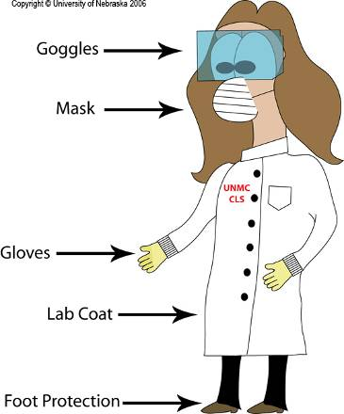
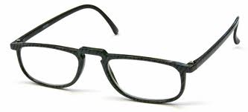
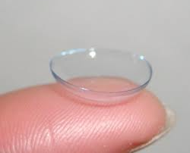
Personal Protective Equipment
Experimenting
Long hair tied up
vs.
IN THE LAB
Notes:
As a first thing, put on your personal protective equipment.
Wear a lab coat to protect clothes and skin from chemical splashes- buttoned and long sleeves
You must wear eye protection when working with solvents/chemicals other than water. Even when you are not using the chemicals yourself, by accident a splash by a colleague could end up in your eye.
In case something ends in your eye, wash eyes with a lot of running water and go see the doctor
You must wear appropriate gloves when handling chemicals, gloves that will not be decomposed by a chemical
Footware with covered toes, so no flats and sandals in summer
In some cases using mask is mandatory. You will get this information from MSDS
Long hair must be tied up so they won’t be in front of your face and in your experiment.
When considering whether to use glasses or contact lenses in the lab, glasses are recommended. Vapours of chemicals ruin the contact lenses rather quicly and it could be unsafe for your eyes.
Personal protective equipment that is meant to protect you in the lab must be used in the lab. When you exit the lab, make sure to leave your personal protective equipment in the lab.

Slide 13
General rules
Experimenting
Move carefully- don’t rush
Food and drinks forbidden in the lab and don’t put anything in your mouth
Don’t touch your face
When experimenting in the lab, keep your personal things in the office
Don’t be alone in the lab when making dangerous experiments
Headphones prohibited
Notes:
On this slide are brought the general rules that must be obeyed:
Move carefully to avoid running anything over, stumbling, spilling chemicals etc.;
Bringing food and drinks in the lab is not allowed;
Do not put anything in your mouth- including the tip of your pen when thinking;
Do not touch your face or hair with contaminated hands and gloves. This includes touching of smartphones;
When experimenting in the lab, keep your personal things in the office;
Don’t be alone in the lab when making risky and dangerous experiments- in case something happens, there will be someone to help you;
Headphones are prohibited in the lab. You should be extra alert to sounds which could inform you about hazards (sizzling, whistling, someone calling help, fire alarm etc.)

Slide 14
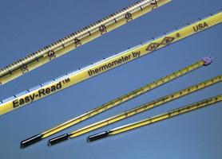
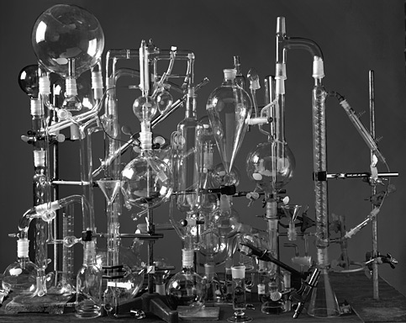
Handling glassware
Experimenting
Handle with care
Don’t carry glassware around the lab more than necessary
Choose glassware appropriate for the task
When broken, sweep the area. Remove small pieces of broken glass with damp paper
http://www.abelardomorell.net/photography/lighttime_01/lighttime_01.html
Notes:
Let’s move on to handling glassware.
We know that glass is a fragile material, therefore it must be handled with care. This also means that you need to think through your experiment in a way that you do not need to carry glassware around the lab more than necessary.
For experiments choose glassware appropriate for the task: flasks with suitable volume and shape. Do not use glassware with special purpose for other purposes- for example round bottom flasks (meant for carrying out chemical reactions) for storage.
Despite being careful, sometimes glassware may get broken. Sweep the area and remove small pieces of broken glass with damp paper. Make sure not to injure yourself. Tell the person who provides the lab with necessary items about the accident, so that the replacement can be ordered if necessary.

Slide 15
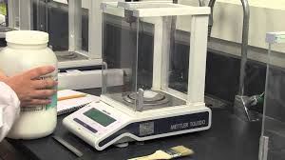
Using analytical balance
Experimenting
Organize your weighing: get
a weighing bottle, a weighing tray, or a weighing paper
clean scoops/spatulas
chemicals
to the weighing table
maximum weighing capacity (including tare)
be spearing with chemicals- use as much as you need
do not pour the excess back into the original container- use a separate clean flask for it
write down all 4 decimal places
clean your mess
Label
Notes:
Almost every chemistry experiment requires weighing procedure. To be efficient, gather the items you need for weighing next to the balance: a weighing bottle, a weighing tray, or a weighing paper- never weigh your substance directly on the balance pan!; clean scoops/spatulas; chemicals. This prevents from running back and forth in the lab during weighing.
Also, think whether you need to consider extra personal protective equipment like respirator or mask or weigh your chemicals altogether under fume hood.
You should know the maximum weighing capacity of the balance, including tare. Be spearing with the chemicals. If it happens that you put too much chemical in your weighing bottle, do not put the excess back into the original container. This is one of the most important rules in chemistry lab. This is to avoid contamination of the original chemical. Use a separate flask for pouring the excess- you can use it the next time.
Write down all 4 decimal places when using an analytical balance and after weighing clean the table. Remember to label your flasks by marking down the content of the flask, name of the owner and the date. Unlabelled flasks could cause misunderstanding and unawareness of how to treat the flasks followed by accidents.
Watch a Youtube video about the mistakes that can be made on weighing by clicking the image.

Slide 16
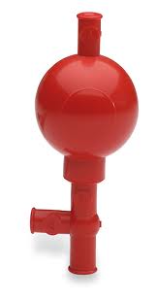
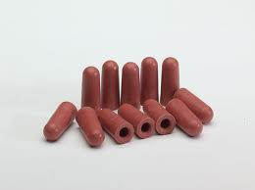
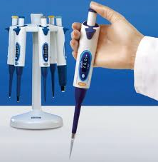
Pipetting
Experimenting
Pipette bulbs, automatic pipettes
Beware of contamination and ruining the pipette by turning it upside down!
Notes:
Besides weighing, the amount of chemicals may also be measured in volume using a pipette. We have pipettes that require using a pipette bulbs, but also automatic ones. I shall not go into details how to use an automatic pipette or pipettes with pipette bulbs, but in case of automatic pipettes, please read the manual first to be sure to measure accurate volumes. Short instructions in Estonian are also available on IMS wiki site.
The manuals of the instruments in the lab can be found in the lab: Look for a drawer with marking „MANUAALID“.

Slide 17
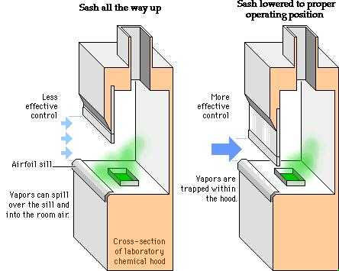
Working under fume hood
Experimenting
Chemicals
corrosive (strong acids and bases)
poisonous
flammable
explosive
is in work mode
still need Personal Protective Equipment
http://healthsafety.etsu.edu/training/preview/id/8
Notes:
Experiments with corrosive, poisonous, flammable or explosive chemicals require working under fume hood, also in case anything just smells intensively like acetic acid. On the slide is shown why it is important to lower the sash to operating position: otherwise vapours won’t be trapped within the hood. When starting working under fume hood, always check whether the hood is in the working mode. Despite being protected from the chemicals by a sash you still need personal protective equipment.
Do not store unnecessary items under fume hood not to occupy valuable working area.

Slide 18
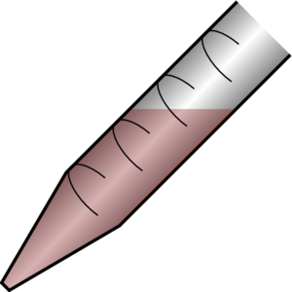
Strong acids and bases
Experimenting
Dilution
Hydration reaction of sulfuric acid is highly exothermic
ρ ˃ ρ
Spills
neutralise and clean
Acid
Water
H₂SO₄
H₂O
Add the acid to the water rather than the water to the acid
Notes:
When you need to work with strong acids and bases, work under fume hood. When diluting strong acids and bases add acid to water, not the other way around. For example, when add water to sulphuric acid, you will witness a highly exothermic hydration reaction of the acid. Also, adding water rapidly to acid may result in splashing of the hot acidic solution due to lower density of water. In case of spilling, neutralize and clean the surface.

Slide 19
Cleaning

Slide 20
Waste disposal
Cleaning
Concentrated acids and bases
do not pour in the drain
neutralize with weak base or acid, respectively
Collect dangerous chemicals into special waste disposal containers
Don’t mix
Special container for glass disposal
Notes:
Before cleaning we must me deal with the waste.
Dangerous chemicals must be collected into special waste disposal containers present in our chemistry lab. Do not mix different wastes to avoid unwanted and surprising dangerous reactions. Concentrated acids and bases must not be poured down the drain. Small quantities can be diluted and neutralized: acids with weak bases and bases with weak acids.
There is also a special container for glass disposal in our lab.

Slide 21
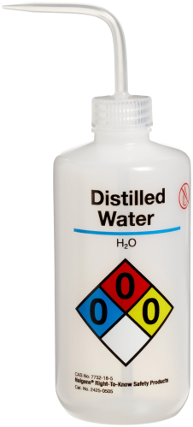
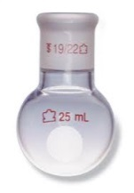
After experiment
Cleaning
After work clean your work spot
Clean spills immediately
Clean properly your table and utensils, so that others can also use them
Washing labware
washing
rinsing thoroughly with distilled water
put to dry
place clean dry items back to where they belong
Before exiting the lab take off your PPE and wash your hands
Notes:
After you have finished with your experiment, make sure to clean your work spot. Spills clean immediately. Clean properly the utensils and labware so that others can use them without the need to redo the cleaning before the use.
Washing labware differs from washing dishes at home. Sometimes you need to use solvents other than water to remove chemicals from labware; maybe you need to use a special detergent (special detergent for washing labware is easily rinsable i.e. No traces of it will be left on the labware to affect your next experiments.
The last step after rinsing labware thoroughly with tap water is rinsing all surfaces with deionised water to wash off the all the ions present in tap water. Analytical purity will be achieved after rinsing 3 times.
The technique of rinsing and filling of the wash bottle will be shown in the lab.
If necessary, repeat cleaning. Do not put unclean labware into the cupboard.

Slide 22
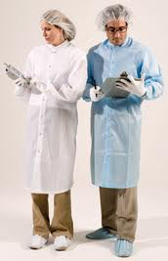
Gray room special requirements
Do not bring dusty or linting items or materials
Entering clean area
PVC curtains
Do not open the windows
Dressing area
Clean area
Bench
Sticky mat
Notes:
Now we’re moving on to the gray room or clean lab with minimized dust level where in addition to general rules extra rules apply. This lab is equipped with instruments sensitive to dust, therefore it is not allowed to bring dusty or linting items to this lab. Before entering the clean area, you must put on special clean lab personal protective equipment: lab coat, cap, gloves and shoe covers. In case of bare legs also special pants must be put on.
The procedure of dressing and entering clean area will be instructed on the site.
To minimize the level of dust, the incoming air (automatic ventilation) is filtered through HEPA filters. Opening windows is prohibited (except in the case of emergency).

Slide 23
Fire safety and how to act in the case of emergency
Notes:
Because of flammable and explosive chemicals in the lab, fire is a very dangerous thing. If we need to use open fire (gas burner, spirit lamp) we must consider all the safety aspects. Keep the evacuation path clear of things.

Slide 24
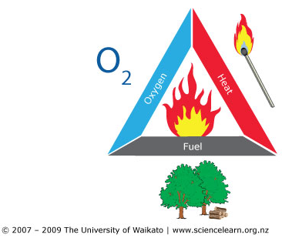
Fire safety
Keep flammable chemicals away from fire
In case of explosive fumes- at least 2 m from fire
Combustion of liquids:
eliminate oxygen
extinguish open fire
fire blanket
CO₂ extinguisher
NB! Water may be used only in case of unlimited miscibility like ethanol
Notes:
Keep flammable chemicals away from fire, in case of explosive fumes- at least 2 m from fire.
Fire has three components: fuel, oxygen and heat. Combustion or spreading of fire can be prevented by eliminating one of the components. In the case of combustion of liquids eliminate oxygen. Distinguish open fire with fire blanket or CO₂ extinguisher.
NB! Water may be used only in case of unlimited miscibility like ethanol.
Know where is the fire extinguisher, fire blanket and first aid kit in the lab. Examine the evacuation plan.

Slide 25
Electrical appliances
Before starting
read the manual
check wire and plug
When working
When noticing overheating, sparkles and/or smoke, stop working and unplug the appliance
When ignites, unplug the appliance (better to use switchboard); distinguish fire using a blanket or CO₂, not water
Beware of hot instruments
Notes:
Fire may start also from electrical appliances.
Before starting read the manual and check that wire and plug are in order.
When working, pay attention. When noticing overheating, sparkles and/or smoke, stop working and unplug the appliance. When it ignites, unplug the appliance (better to use switchboard); distinguish fire using a blanket or CO₂, not water.
Beware of hot instruments. Use special heat resistant gloves when handling hot instruments.

Slide 26
In case of hearing a fire alarm
1st alarm
Go look around in the corridor nearby
Alarm stops
Follow the evacuation plan
Use the stairs
Move calmly in one row
Gather outside the building in the far end of the parking area (next to Chemicum)
Yes
Do you
see smoke or fire?
NEXT SLIDE
No
Wait for the 2nd alarm
Go back to work, but stay alert
No
Yes
Is there a 2nd alarm?
Evacuate
Notes:
Every year there is a practice on how to act in the case of fire alarm at Nooruse 1.
When you hear the alarm, take action. Make sure people around you do the same.
Close the windows and shut the doors (do not lock the doors).

Slide 27
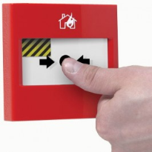
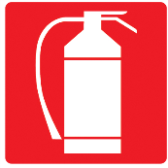
In case of discovering fire:
112 call:
Exact location of fire
What is on fire
Your name and phone number
Save those who are in direct danger
If possible, delegate tasks
Tasks:
Manual call point: switch on fire alarm
Call emergency: 112
Inform University emergency line: 7375111
Let the colleagues know about danger
Start extinguishing
www.alarmtec.ee
Notes:
What if you see smoke coming from behind the door? Touch the door handle with the back of your hand to check the temperature.
Students must inform their supervisor or other employee who must take actions as follows:
Save those who are in direct danger. If possible, delegate tasks.
Switch on fire alarm
Call emergency
Inform University emergency line
Let the colleagues know about danger and tell them to evacuate
Start extinguishing and prevent spreading of fire
Do not overestimate your abilities.
The electricity must be switched off in the accident area
On arrival of the rescue team show the location of fire and give as much information on extra risks as possible
Prevent persons from going to wards the site of fire by stopping the way with band
And one more thing: If you have an opportunity to attend First Aid training- do attend. It does not hurt.

Slide 28
Notes:
Don’t let yourself be distracted while working, keep in mind what I just taught you, think, verify if you doubt or don’t know.
I hope you will still enjoy working in the chemistry lab.

