Slide 1
„What’s the use“ ...
Friedrich
12.09.2014

Slide 2
Fiber measurment
Load sensor
REF
CE
Fiber

Slide 3
Some first results
CNT-CDC
CA 4cycles 50 sek +-1V

Slide 4
Some first results
CNT-CDC-PPY

Slide 5
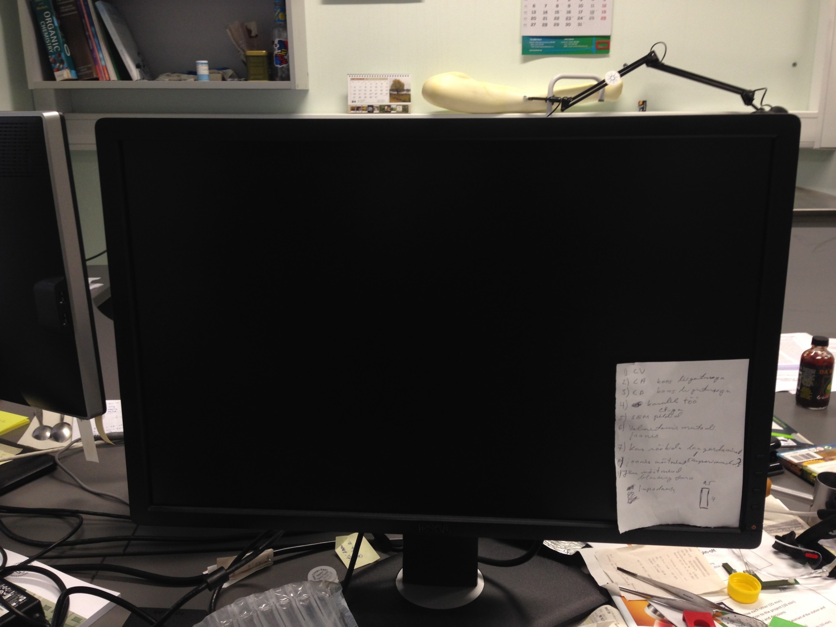
Future plans

Slide 6
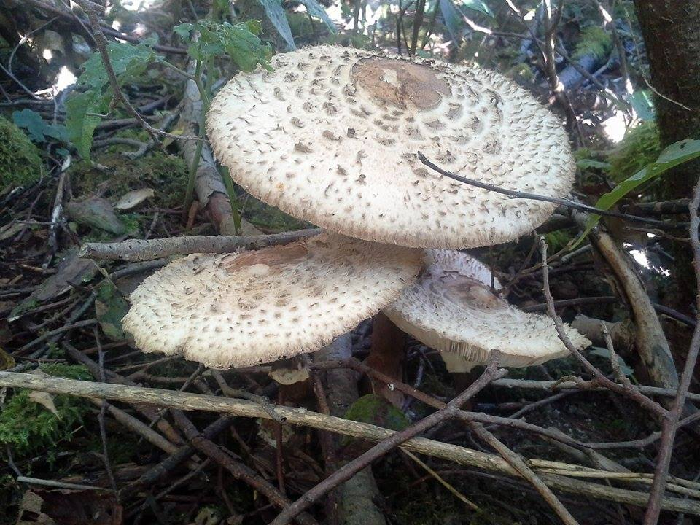
Mine metsa!
Have a nice weekend!

