Slide 1
Diabetes and noninvensive sensing of glucose
Presentation in Journal Club 04.11.2014
Veiko Vunder

Slide 2
About diabetes
Diabetes
defects in releasing insulin
defective insulin
the cells are not responding
Insulin
released into the blood by beta cells (after eating)
Stimulates transport of glucose into fat and muscle cells
Glucagon
Hormone that stimulates glycogen conversion into glucose

Slide 3
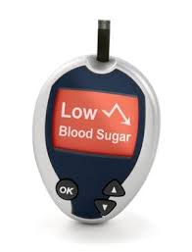
About diabetes
Huge and growing problem affecting one in every 19 people on the planet
8th leading cause of death
Uncontrolled blood sugar -> damage to:
Eyes
Kidneys
Heart, …

Slide 4
About diabetes
Glucose levels changes
activity like exercising
eating
sweating
Need for continous monitoring

Slide 5
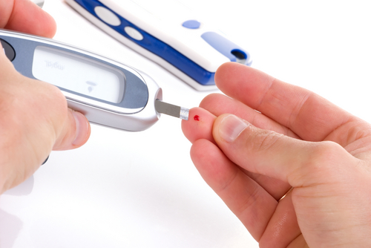
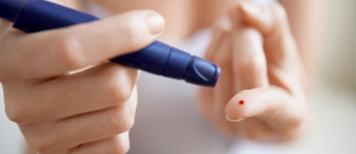
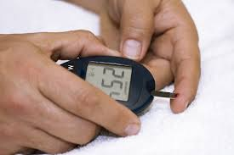
How to measure the level of glucose?
Blood test
Disruptive
Painful
Accurate
Need for a non-invasive method

Slide 6
Noninvasive possibilities
Tears or other body fluids
Thermal/Electromagnetic/Ultrasonic

Slide 7
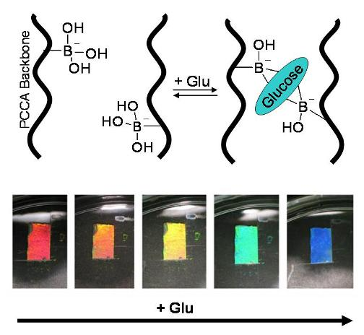
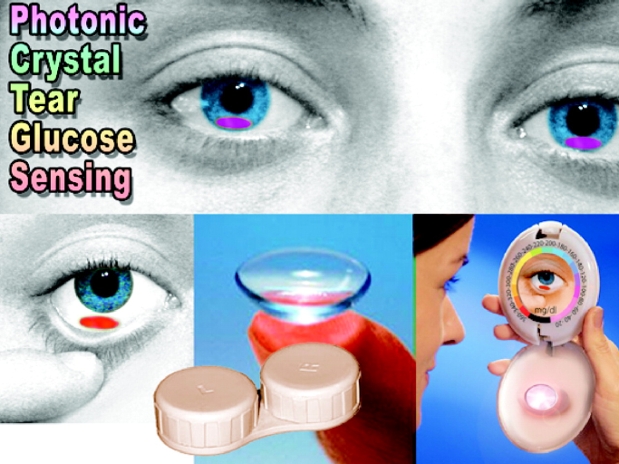
Tears, contact lenses
Method 1:
boronic acid + sugar = fluorescence
glows if blue light is shown on the eyes
Method 2:
boronic acid + polymer chains with receptors + glucose = rainbow
Color visible on the lower part of contact lenses

Slide 8
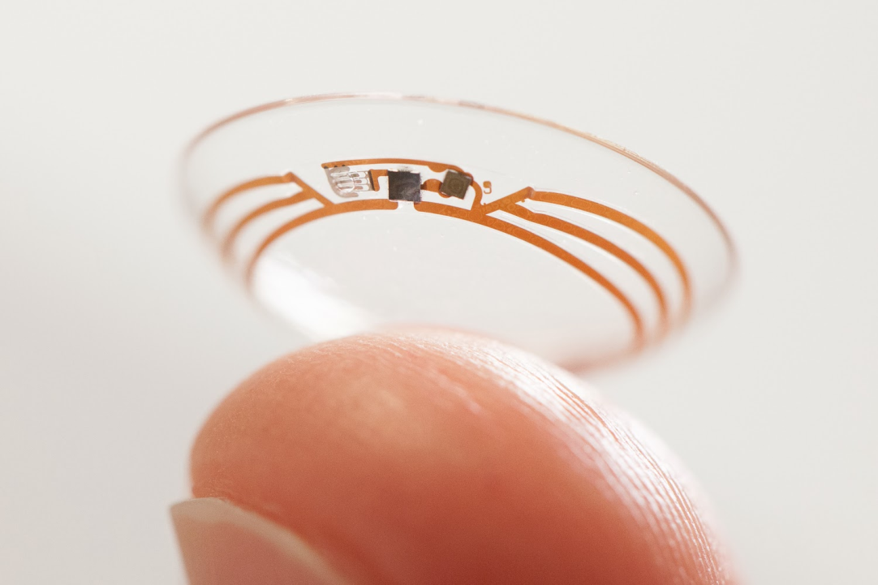
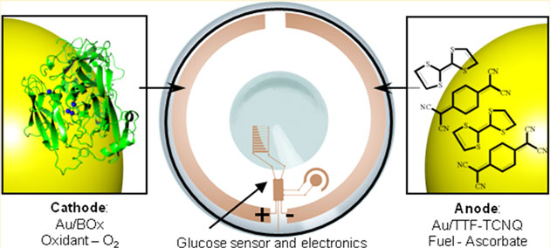
Google Contact Lens project
Analyze glucose level in tears
Display the reading

Slide 9
Blood glycose level reaches tears in 30 minutes!!!

Slide 10
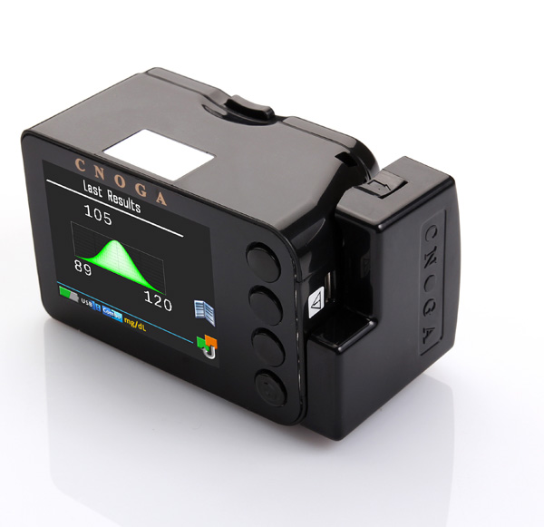
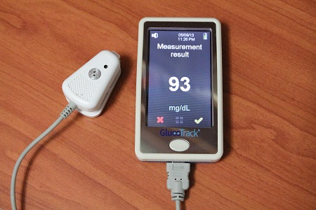
Thermal/Electromagnetic/Ultrasonic
Noninvasive
Fast
Accuracy?

Slide 11
Noninvasive in vivo glucose sensing on human subjects using mid-infrared light (biomedical optics express), Sabbir Liakat, et al, Princeton univ.
near-infrared light 1.3 – 1.9 μm
Difficult to distinct glucose from other proteins and acids
mid-IR 8 – 10 μm
vibrational glucose absorption features
high water absorption

Slide 12
The method
Photoconductive Mercury Cadmium Telluride Detector

Slide 13
Aqueous glucose vs human spectra

Slide 14
Spectra of a palm (during eating jellybeans)

Slide 15
10 mid-IR human spectras

Slide 16
Clarke error grid

Slide 17
Thanks for your attention

