Slide 1
Synthesis of EAP actuator
Inna Baranova,
Fred Elhi,
Robert Valner

Slide 2
Initial setup
Synthesized an EAP actuator.
Precut PVdF strip.
Synthesis with pyrrole and sodium dodecylbenzenesulfonatein (NaDBS) in 0,1 M sodium carbonate.

Slide 3
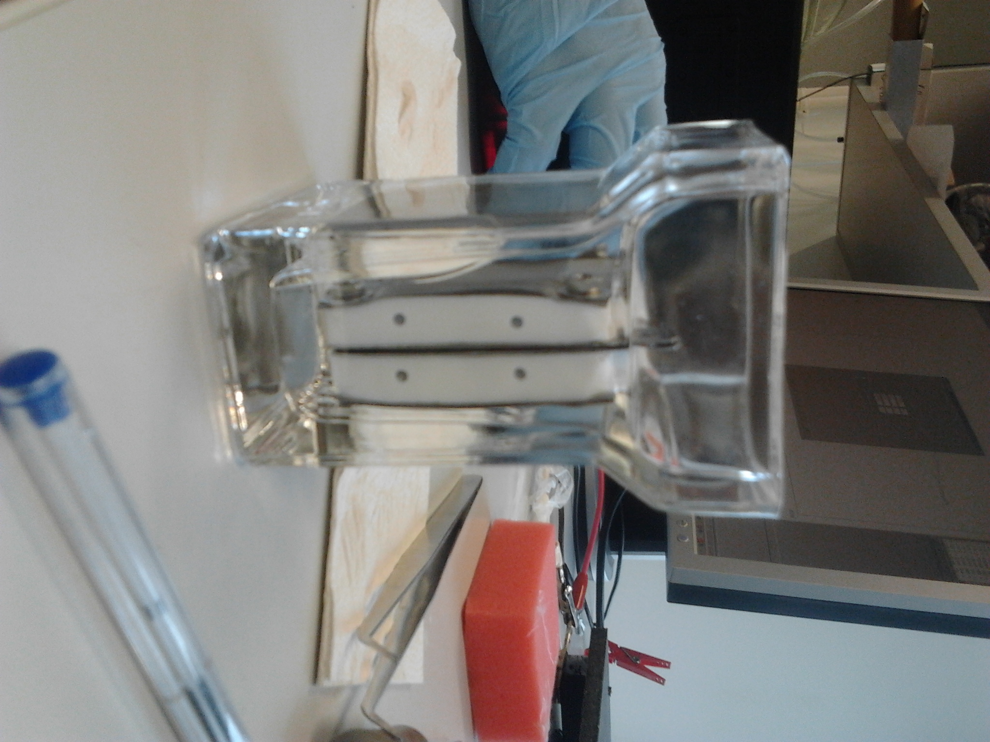
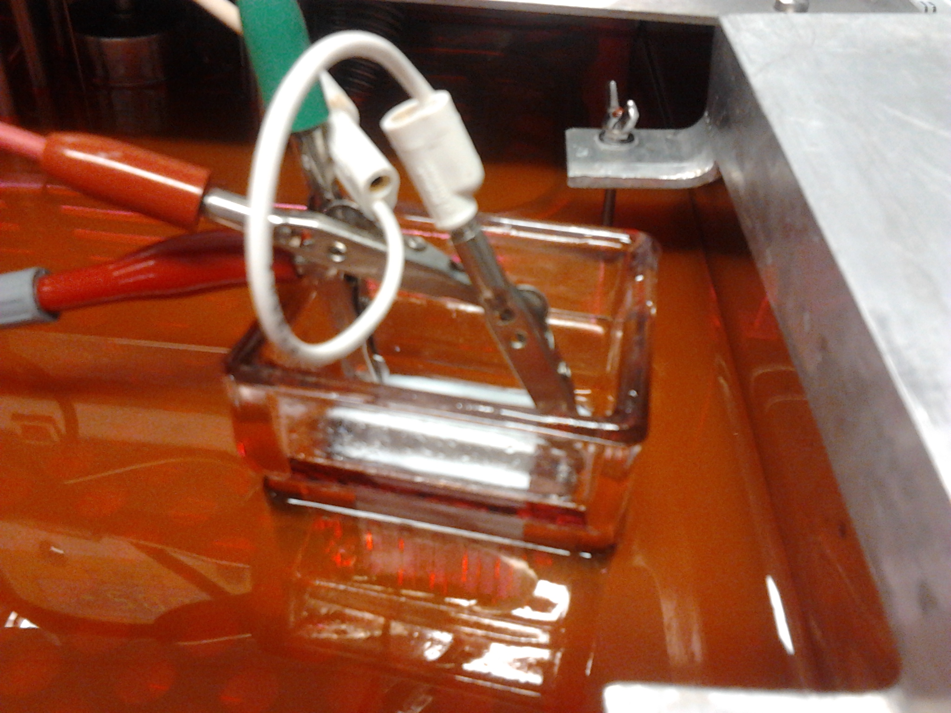
Synthesis
Two electrode system.
20 sec for 1 polymerisation.
Synthesis for ~ 5 h in ethylene glycol in PARSTAT.

Slide 4
Polymerization

Slide 5
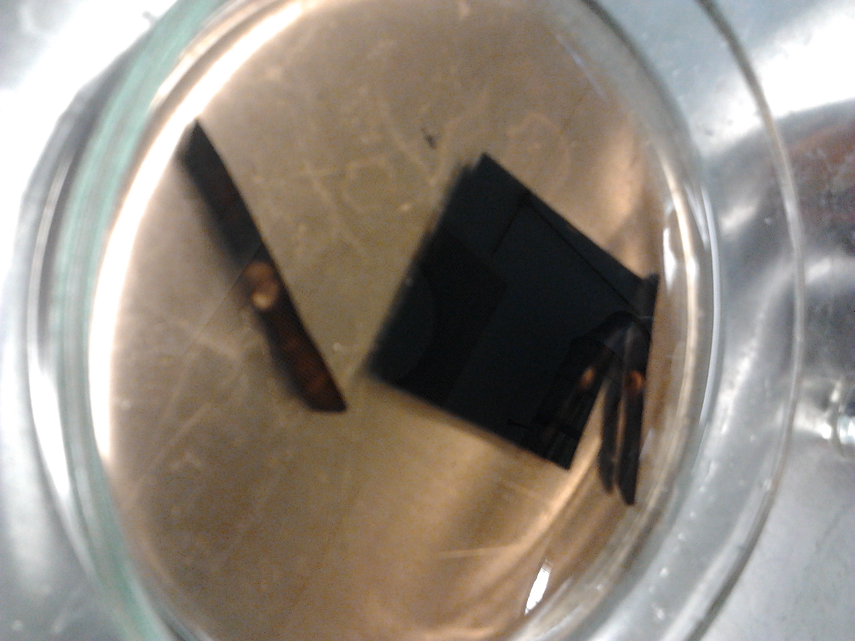
Delamination

Slide 6
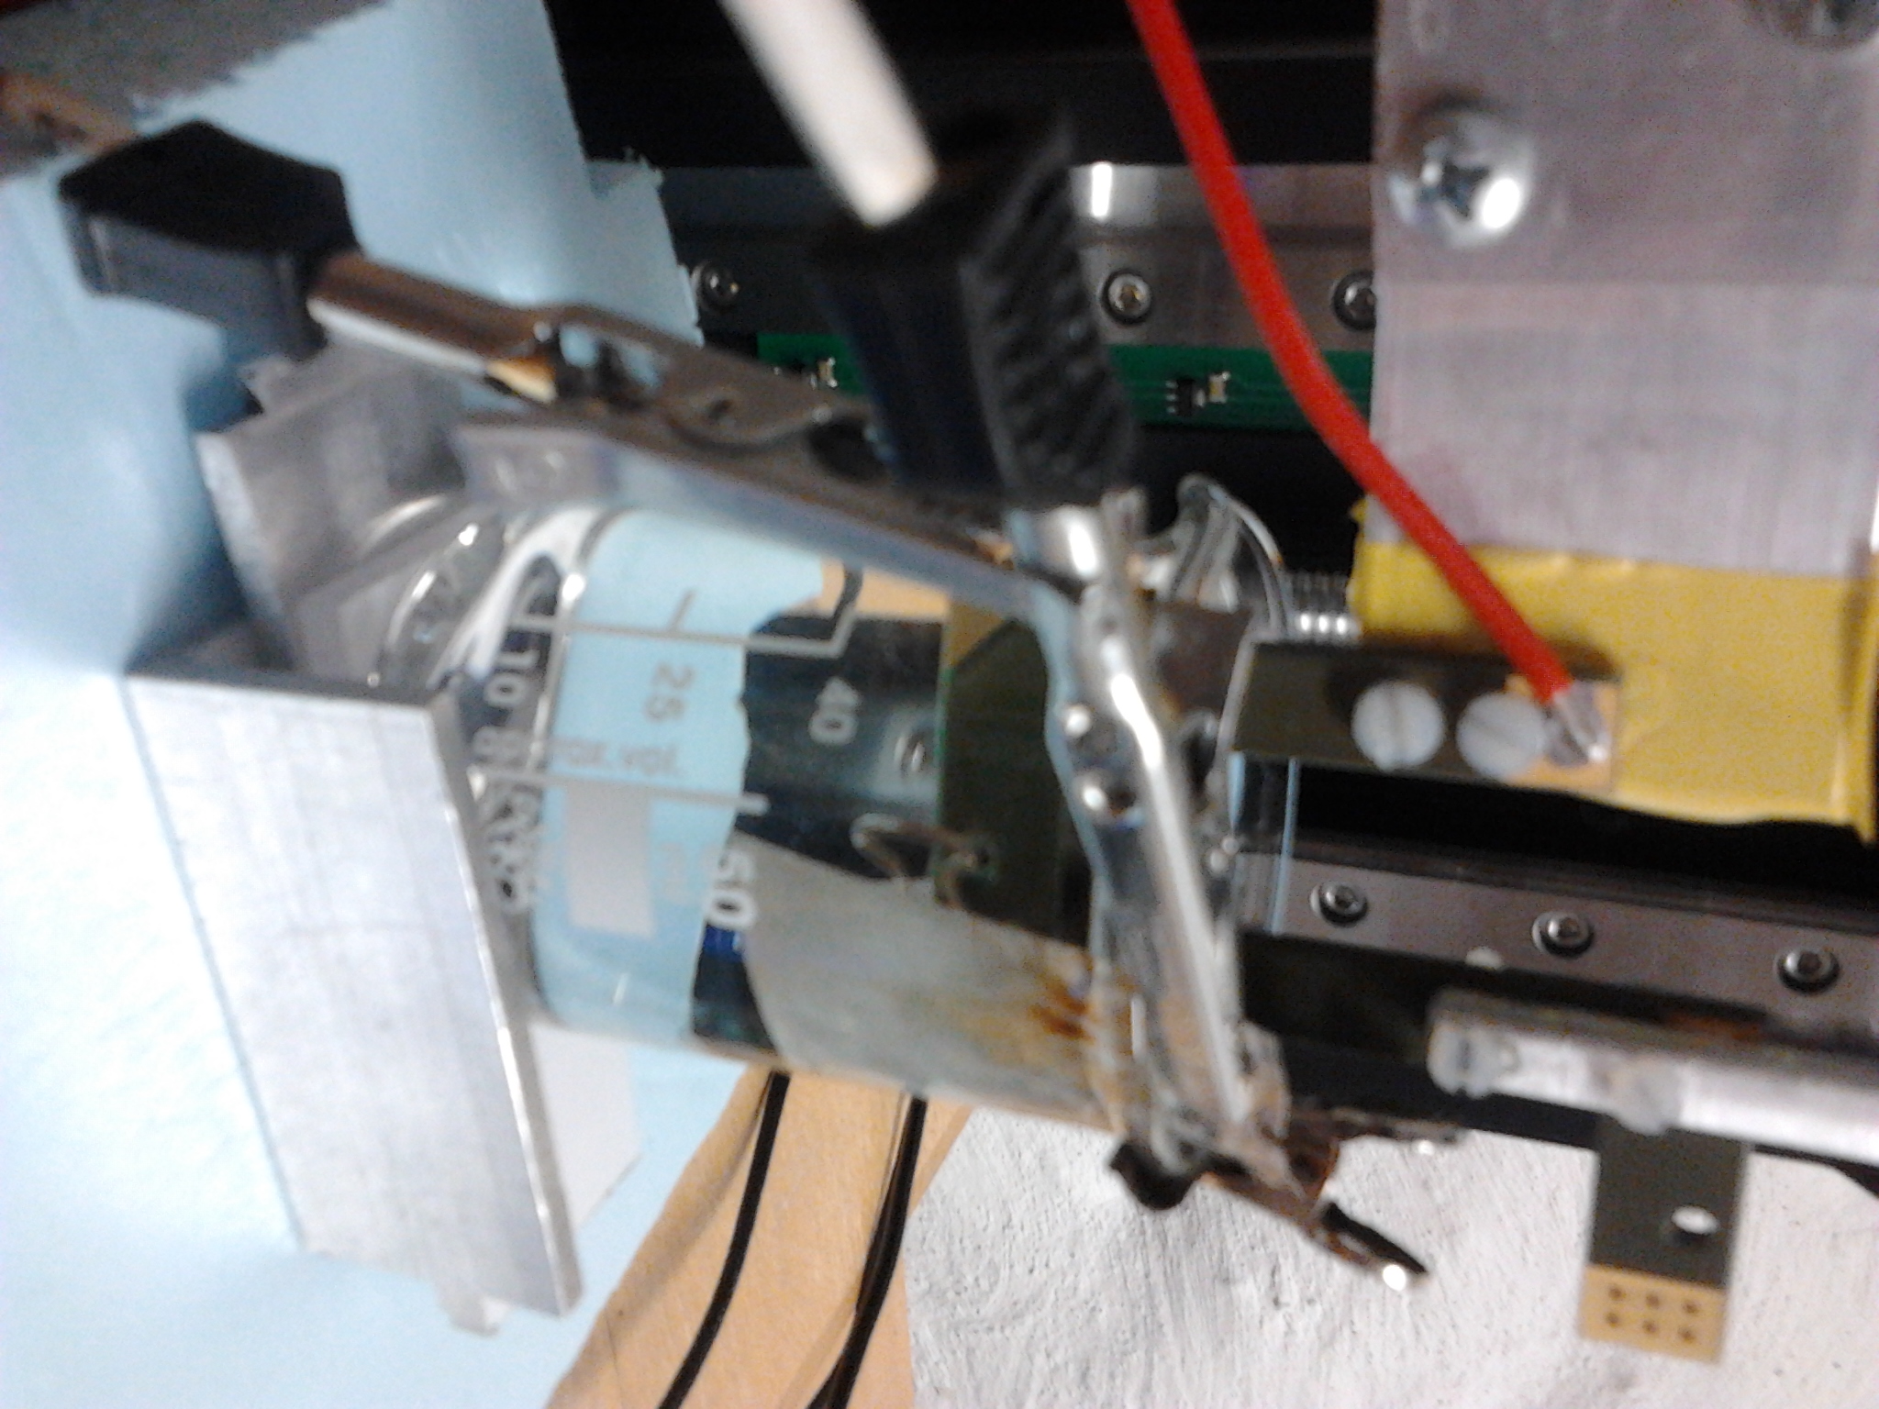
Force measurements
Polypyrrole triflate PVdF actuator.
Measurements in 0,1 M propylene carbonate triflate.
Dimensions of the actuator:
2,5 mm x 19 mm
Notes:
TF – tereftalaat, triflaat ?

Slide 7
Cyclic voltammetry

Slide 8
Chronopotentiometry

Slide 9
Chronoamperometry

Slide 10
Thank you for your attention!

